Slide 1

Zeldat Team Slippee
Zeldat Extracts Loaded Data and Translates

Slide 2



The Team
Isaiah Bessire
ibessire1@ewu.edu
Devin Harrison
dharrison5@ewu.edu
Matthew Christoff
mchristoff@ewu.edu

Slide 3
Problem statement
The landscape of Nintendo 64 (N64) emulation is fragmented, with each major emulator utilizing its own format for storing save data. This inconsistency creates challenges for users who wish to transfer save progress across different emulators or from physical cartridges to digital formats.
This project aims to provide a seamless and intuitive tool for translating N64 save files between popular emulators as well as converting physical cartridge data into compatible emulator formats. The tool will prioritize effectiveness, versatility, and user-friendly design to ensure broad accessibility and functionality.

Slide 4
Requirements List
FR1: Bidirectional Conversion Support Conversion should be 1:1, can be done in any direction at any time
FR2: File Validation and Error Handling Only valid files should be accepted, and any others are ignored
NFR1: Help page for new/inexperienced users A guide for the application intended to help novice users
NFR2: Usability The GUI interface should be accessible and easy to understand, allowing inexperienced users to accomplish their goal

Slide 5
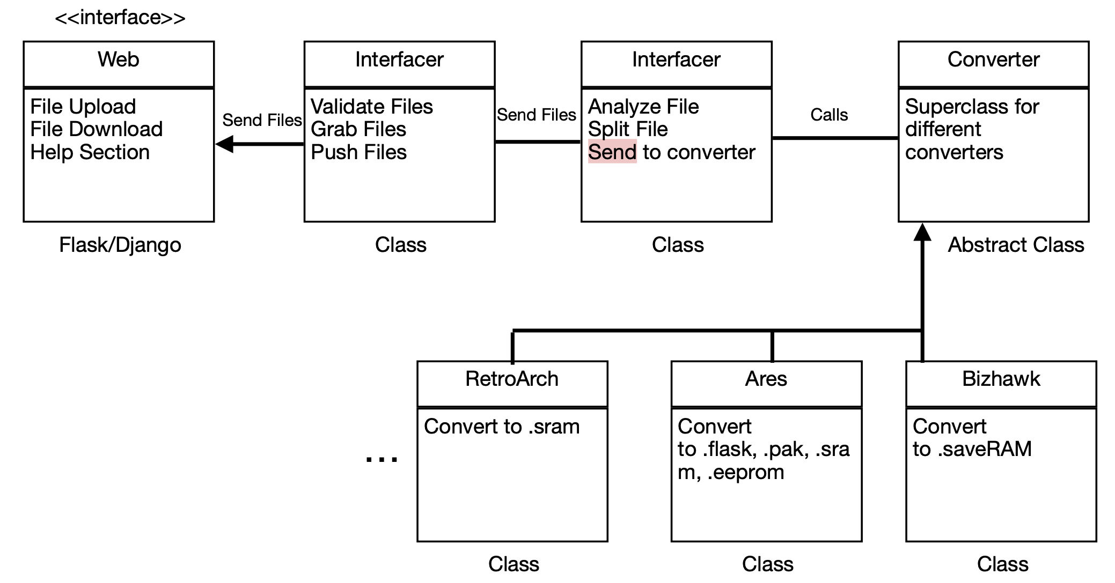
System Architecture Diagram

Slide 6
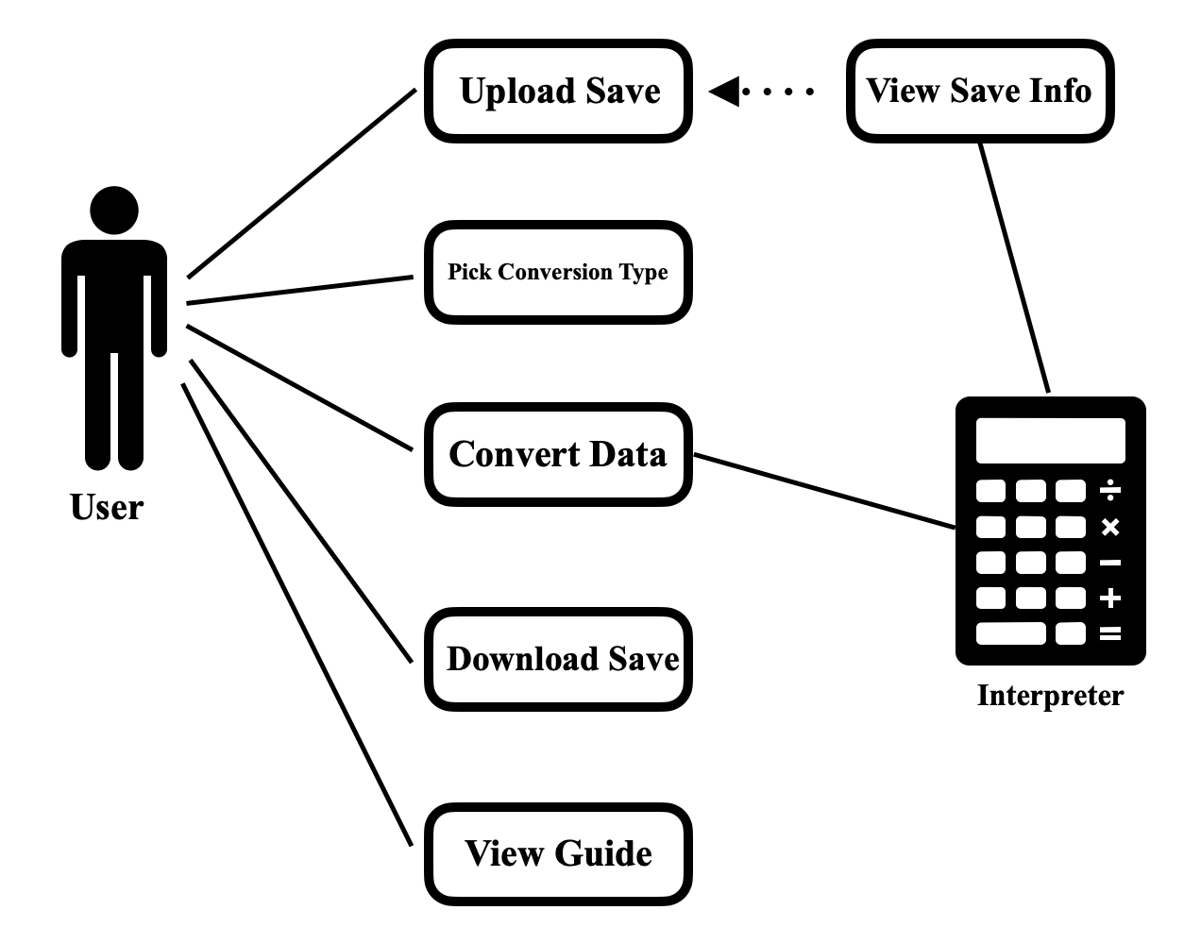
Use Case Modeling

Slide 7
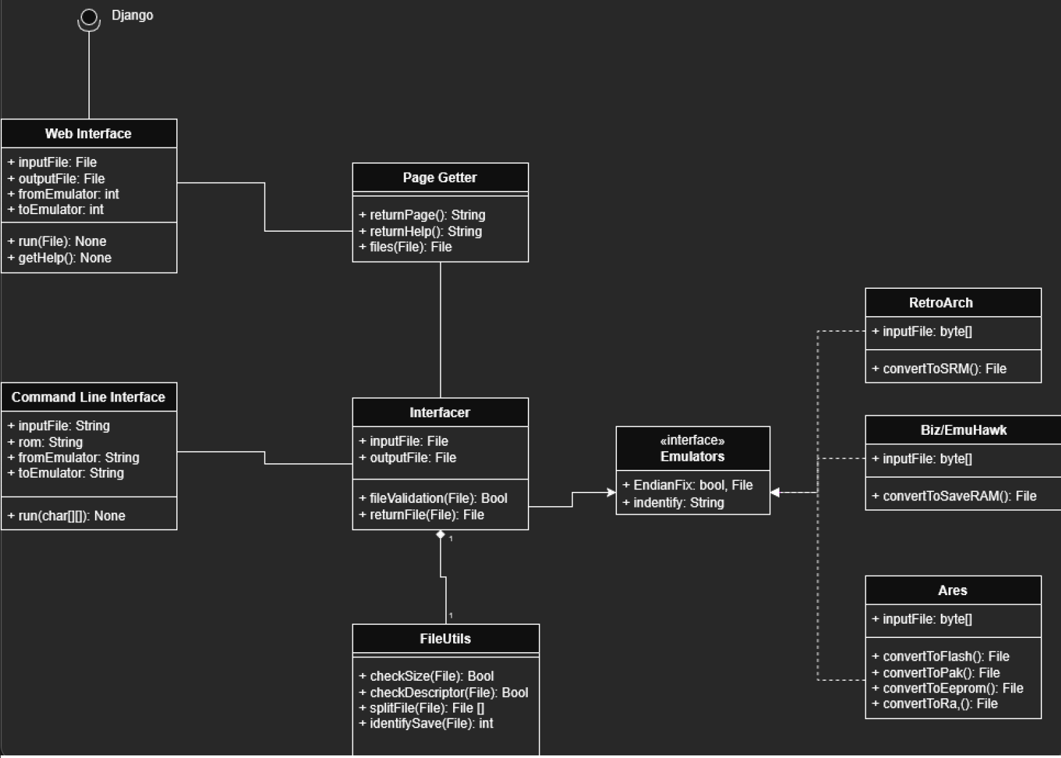
Structural Modeling: Class Diagram

Slide 8
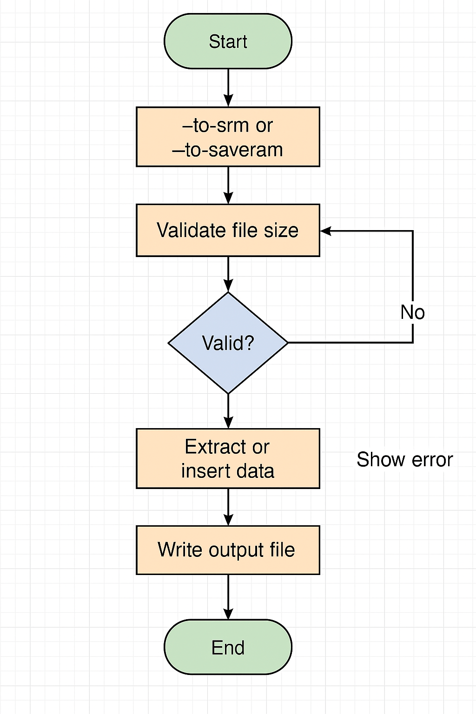
Behavioral Modeling: Sequence Diagram

Slide 9
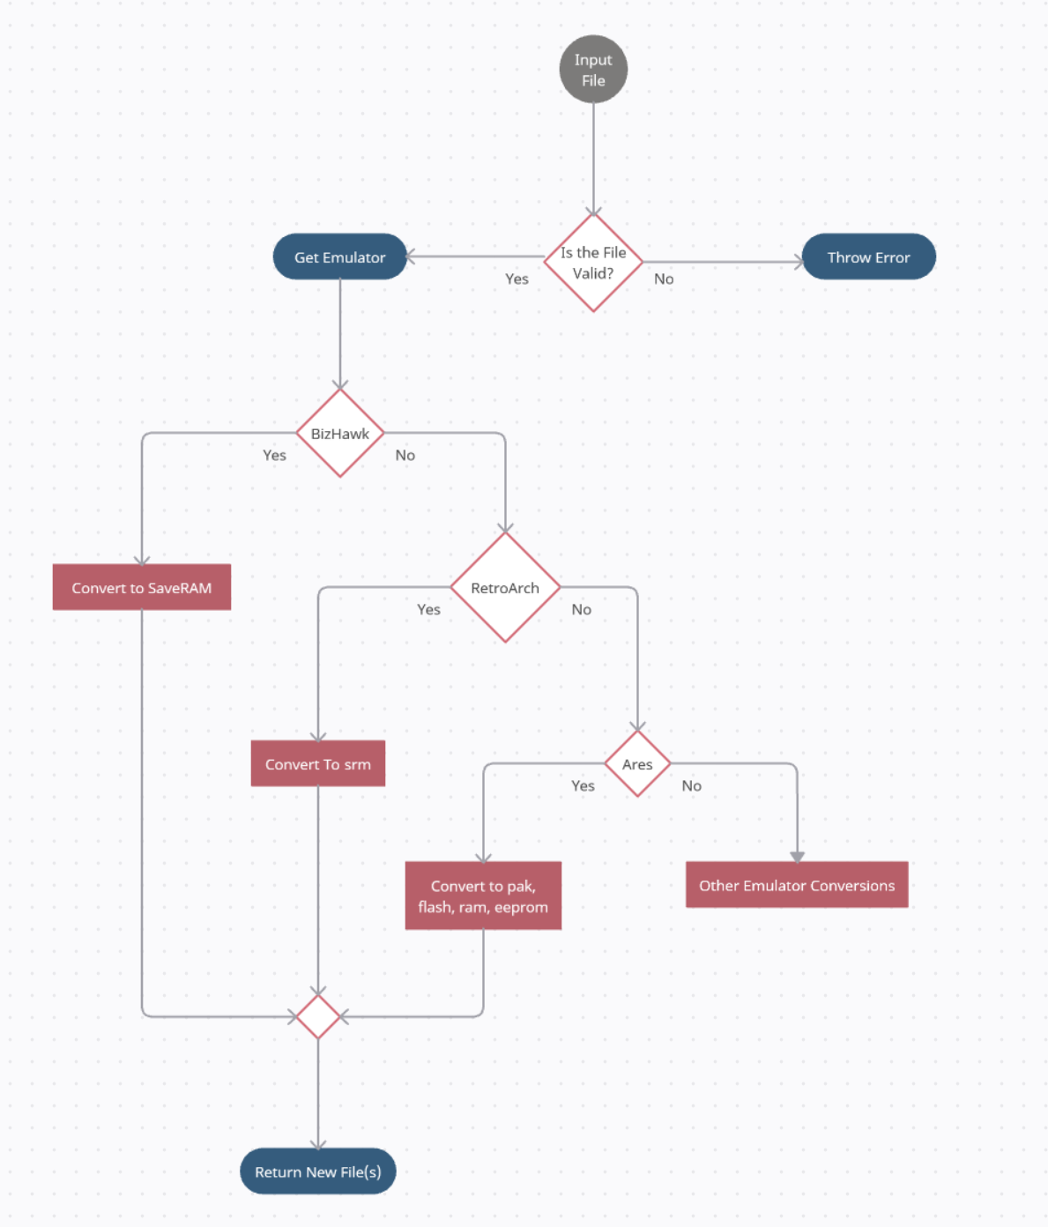
Behavioral Modeling: Activity Diagram

Slide 10
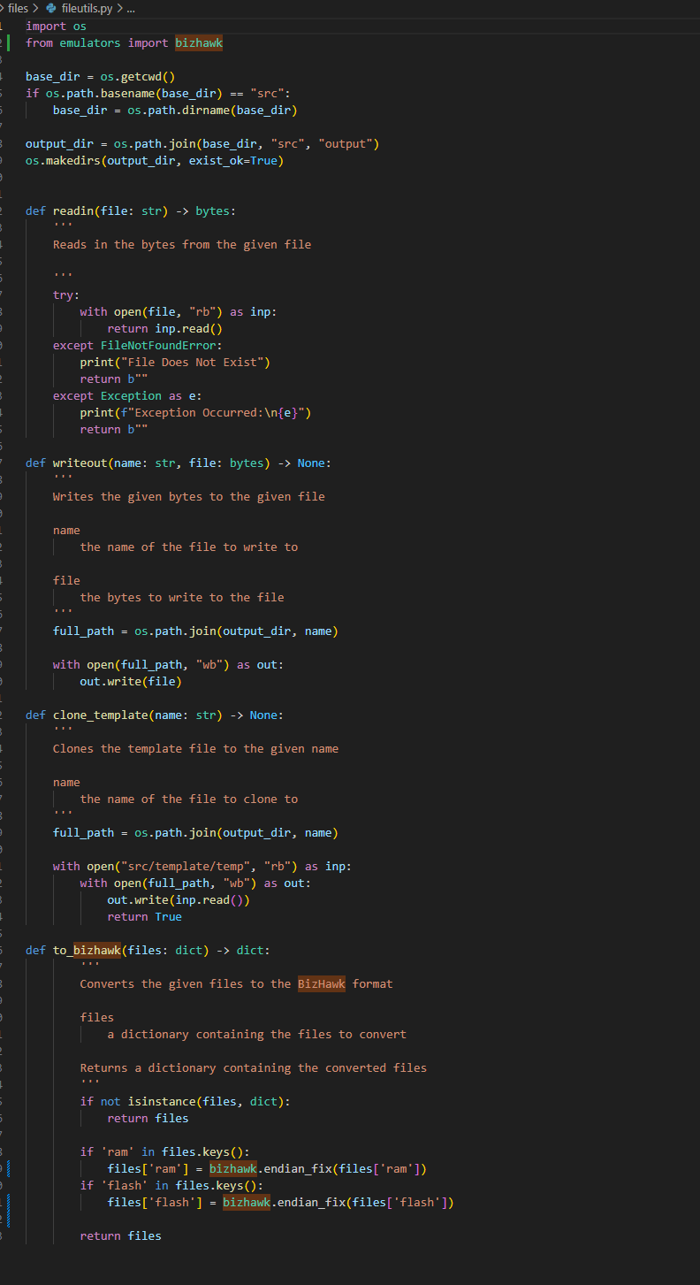
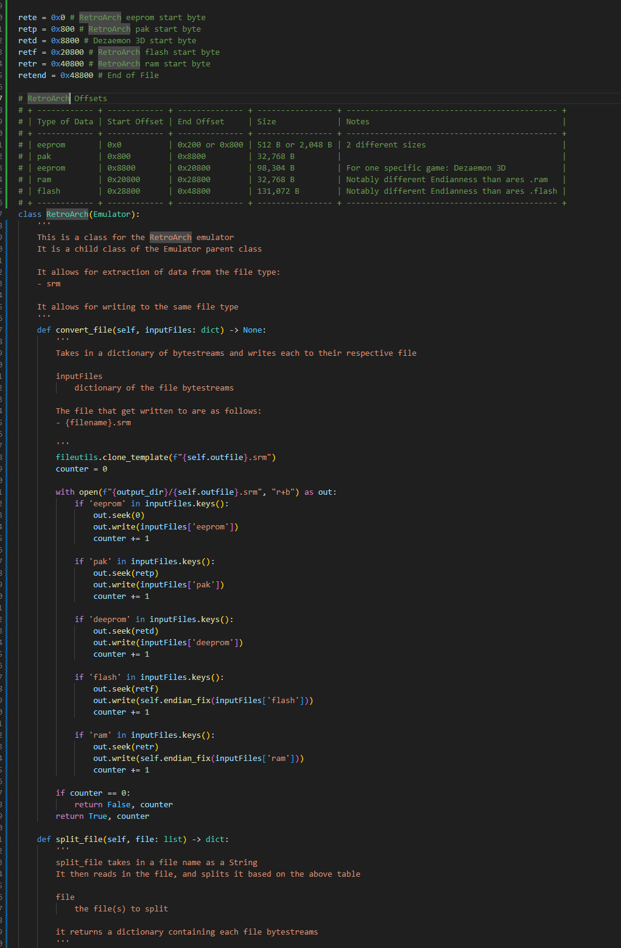
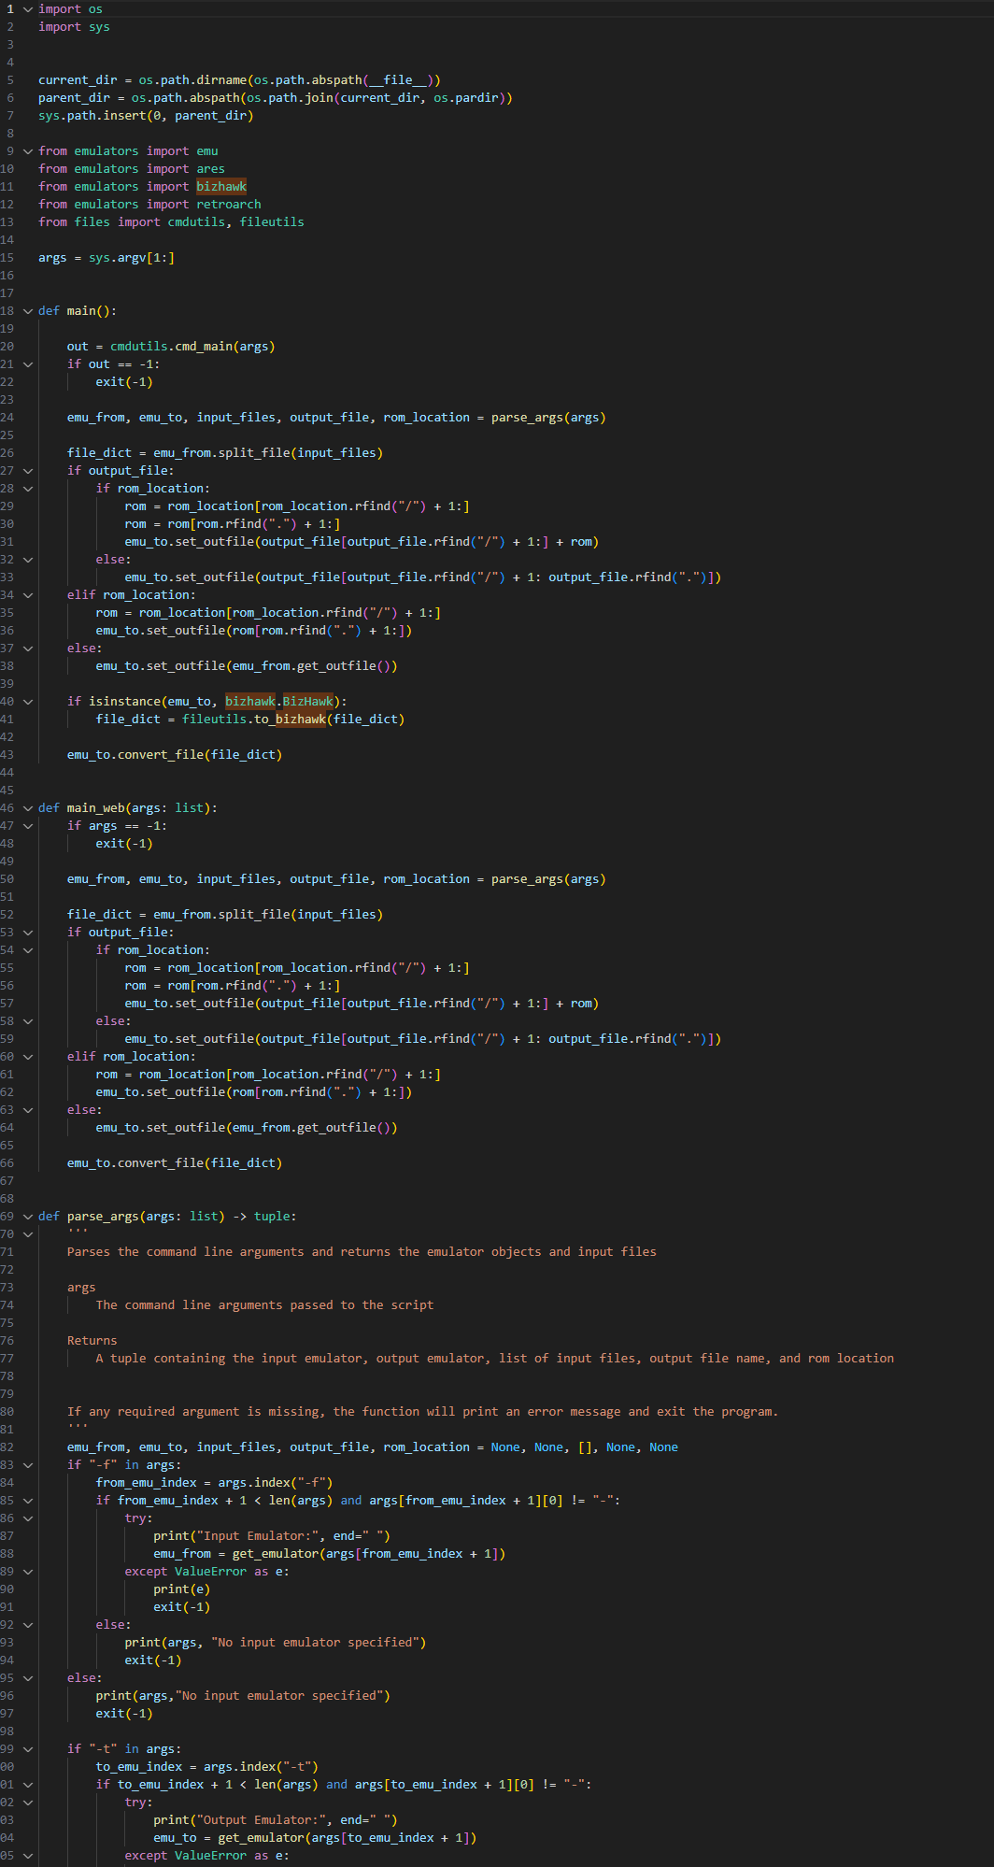
Screenshots (Code)

Slide 11
Implementation details
Local application using a WebUI
Django backend
Hosted locally (e.g. localhost:64646)
Allows easy file ingestion & creation in python
Also used a mix of HTML and CSS for the graphics

Slide 12
Tools, Technologies, and Testing
Tools, frameworks, platforms
Django and htmx for the web interface
Main back end was Python
Pytest for testing the backend, and Django’s builtin testing for frontend
Coverage.py to address code coverage

Slide 13
Part 2 Demo

